Slide 1
Creating a Breastfeeding Support Network for Continuity of Care

Slide 2
Conflicts of interest
No conflicts of interest to report

Slide 3
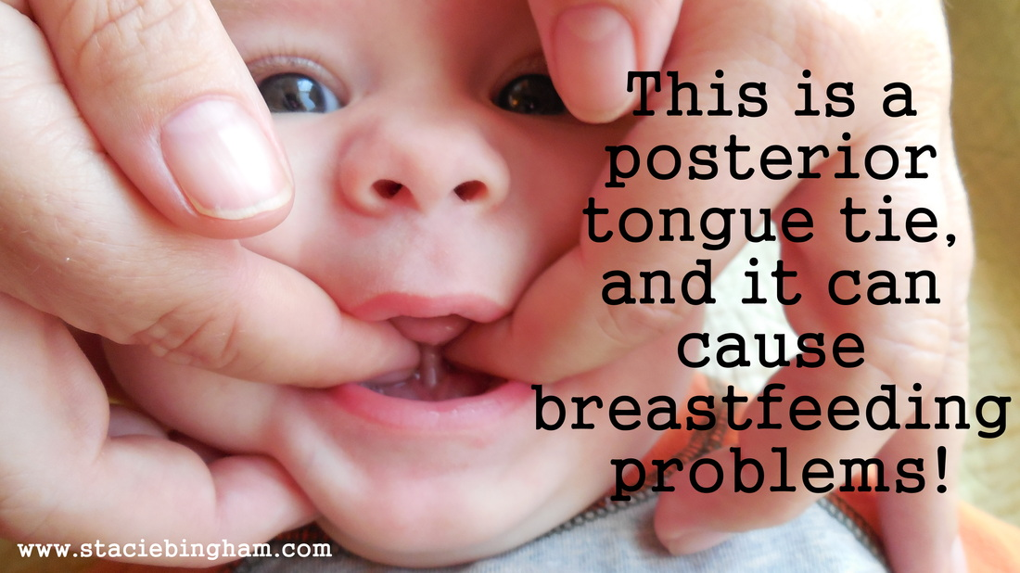
The Tongue Tie Project

Slide 4
Who am I?
Katie Jacobe, MD
Assistant Professor of Family Medicine at MCW – Fox Valley Family Medicine Residency Program
Family Physician at Mosaic Family Health
Special interest in supporting breastfeeding families
Special interest in diagnosis and treatment of tongue and lip tie
Breastfeeding mom
Mom to 2 tongue-tied children

Slide 5
What is the Tongue Tie Project?
Joint collaboration of Wisconsin Association of Lactation Consultants and Breastfeeding Alliance of Northeast Wisconsin
Truly started as the work of 1 mother whose daughters were affected by tongue tie.
Goal: To educate providers across the region about the facts regarding symptoms and diagnosis of tongue tie (anterior to posterior) to provide better care for struggling dyads.

Slide 6
Why are we talking about this today?
Example of how grassroots efforts educated a community and addressed an ongoing problem with a multidisciplinary solution.
The solution involves
Educating physicians, lactation consultants on all levels, speech therapists, chiropractors, other body workers about the problem
Multidisciplinary treatment
Monitoring by a variety of providers with many access points to treatment
Collaboration by a network of providers for the success of the Dyad

Slide 7
The Problem
Tongue tie is common
While formal surveys estimate an incidence of 4% in the population, and informal survey of OUTPATIENT lactation providers in a multidiscplinary professional facebook group had estimated an incidence of 90% in their populations of struggling dyads.

Slide 8
The Problem
Tongue tie impairs normal tongue and mouth function and can cause a variety of impairments and problems for breastfeeding (and bottle feeding).
Not many Pediatricians, Family doctors, or OB-GYNs have much (if any!) training in breastfeeding
These are the people who have guaranteed access to moms and babies.
Even fewer of these providers have appropriate training (if any) in tongue or lip tie (and most importantly in posterior tongue tie)

Slide 9
The Problem
Not all families get sent on to see lactation specialists or speech therapists for breastfeeding difficulties
Dependent on provider, location, provider’s perspective on the problem
Not all lactation consultants or speech therapists are knowledgeable about tongue tie or breastfeeding or the two together or about posterior tongue tie.

Slide 10
Consequences of all of that…
Families needed help
Some found knowledgeable lactation consultants and were then sent on to Illinois for proper release – were paying out of pocket
Some had providers to incomplete releases and then said lack of improvement was evidence that tongue ties aren’t worth treating
Some were sent to ENTs and told these didn’t need correction or the only way to correct is in an OR
Some were told by their providers that some moms just aren’t meant to breastfeed and discontinued or were left to struggle on their own

Slide 11
Consequences of all of that…
Some were referred on to speech therapists who may not have known about ties and had weeks of therapy without much improvement
Some were sent to lactation consultants who didn’t know about ties and who struggled to help them find a solution
Some were told their baby had no ties, simply not given help and just stopped breastfeeding
Some babies failed to thrive and were switched to bottles, or advised to supplement and milk supplies dwindled or were even admitted to the hospital…

Slide 12
Consequences of all that…
Fewer babies breastfed
Shorter durations of breastfeeding
Many believe is tongue and lip tie are identified and treated early as problems are arising, the rate of breastfeeding a several months of age will go up.

Slide 13
Enter
The Tongue Tie Project

Slide 14
Education
The project set out to educate the players in a breastfeeding dyad’s journey
Spring 2013 Wisconsin Association of Lactation Consultants Conference – featured Catherine Watson Genna on infant sucking skills
Lecture by Karen Metzler, MS, Genetic counselor on posterior tongue tie at UW Fox Valley Family Medicine Residency Clinic

Slide 15
Education
WALC grant obtained to address better education among primary care providers AND to help train providers in the treatment of posterior tongue tie
Info packets
Network of Lactation consultants and BFAN working to identify interested providers to “shepherd along”
Copies of Dr. Jain video available to check out to interested providers

Slide 16
Education
Information packet developed
Revew of 107 peer-reviewed journal articles published between 1993 and summer 2013 and “Tongue-Tie: Morphogenesis, Impact, Assessment and Treatment” by Alison Hazelbaker
Packet with 5 key articles, handout on Hazelbaker assessment, resource lists, patient handout and Karen Metzler’s personal story
Physician offices in 5 counties identified
Outagamie, Waushara, Winnebago, Green Lake, Calumet
10-15 minute face to face presentation
Education packet
Copy of Dr. Kotlow’s “breastfeeding should be fun and enjoyable book”

Slide 17
Education - Continued collaboration
November 2014 LLL of Wisconsin’s annual conference featured Drs. Alison Hazelbaker and Lawrence Kotlow – experts in tongue and lip tie
In conjunction with this BFANwi and LLL partnered to plan 2 day long workshops for providers to learn the Hazelbaker Assessment Tool for Lingual Frenulum Function

Slide 18
Education – Continued Collaboration
A number of Hazelbaker tool workshops have occurred across the area through collaboration with BFANwi, breastfeeding moms, LLL groups, and lactation consultants.
Attendees include interested physicians, Lactation consultants, speech therapists, dentists, nurses, etc.

Slide 19
Shepherding of new providers
The story of the project is my story with maybe a little more incentive than some other providers
Knew about tongue tie
Karen’s 2013 talk to the residency about posterior ties
“viewing party” for the Dr. Jain video
Reviewed many of the 107 articles Karen reviewed
Karen connected me with Jennilee Hill to go out and train (was willing to work to get me in with Bobby Ghaheri had I had the travel time and funds)
Connected me with Facebook professionals page so I could learn about multidisplinary care surrounding release
My own experiences with the IBCLC I saw helped connect me with speech, chiropractic providers, understand the importance of lactation support – but I’m getting ahead of myself.

Slide 20
Back to the Problem – The knowledge gap.
Most doctors aren’t formally taught about breastfeeding for more than an hour or two in medical school and possibly a bit more in residency if interested
Everything I know about breastfeeding I learned from other moms, my IBCLC, facebook, books because I took the time to read and educate myself…and my own trial and error.
Remember this gap not only for its impact on tongue tie but for its impact on EVERYTHING breastfeeding
How did I learn when to supplement
How did I learn to evaluate latch
How did I learn anything about pumping
How did I learn what to do when breastfeeding doesn’t go smoothly
For someone used to educating patients from a position of authority it isn’t always easy to see this gap in knowledge or appropriately defer to the people who know the answers

Slide 21
The knowledge gap.
Hadn’t heard of a tongue tie until the lactation consultant in the hospital told me my son had one
Had never seen a frenotomy in all of medical school or residency
Even with my son, wasn’t aware enough to realize that his tongue function still wasn’t great after his anterior release and that is why we couldn’t breastfeed.

Slide 22
The knowledge gap.
Without the training I was able to access through the tongue tie project
With the help of lactation consultants
With the help of knowledgeable moms
With the help of knowledgeable medical providers
…I wouldn’t know much…

Slide 23
Outcomes?
There are now 6 to 7 providers statewide that are believed to be reliable for adequate release and appropriate aftercare recommendations for treatment of tongue and lip tie
4 of these are in the northeast Wisconsin region
We continue to work on education and access
Thedacare has a pediatrician “looking at” tongue tie for their practice – evaluating research, outcomes etc
I have had referrals from local NICU and several pediatricians directly

Slide 24
Our Talk: “Creating a breastfeeding support network for continuity of care”
Collaboration and a support network were key to solving the problem gaps in knowledge about tongue and lip tie and their impact on breastfeeding.
Collaboration and a support network were key in getting me trained to know about breastfeeding and tongue and lip tie and to become a release provider.
But they are ALSO key to proper treatment of tongue and lip tie.

Slide 25
The role of a breastfeeding support network and the importance of continuity of care in what I do every day.

Slide 26
You need a network to treat a tongue or lip tie
Release is 1 part of the puzzle
Other parts
Lactation
Body work
Speech therapy
Primary Care provider reinforcement
Hospital physician
Continuity of care

Slide 27
Network – Role of Lactation
Hospital lactation
Identification of lingual and upper labial frenulums
Even if not ties – relaxin
Reinforcement of the idea that breastfeeding shouldn’t hurt – that is a sign of a problem
Resources for outpatient follow up
Checking in on moms who struggled in the hospital

Slide 28
Network – Role of Lactation
Outpatient lactation – prior to release
Decide if you suspect a tie
Educate/refer if you do
Help support mom’s supply – pumping education
Assist mom with nipple damage
Assist with alternative feeding methods – SNS, bottles?
Helpful to evaluate transfer prior to release (cuz it’s a great marker of progress after release) – weighed feed
Consider referring to body work prior to release (more on this later)
Consider referring to speech prior to release

Slide 29
Network – Role of Lactation
Outpatient lactation – post release
Evaluation of transfer
Help with re-establishing positioning
Help getting babies back to breast (if had been unable d/t symptoms)
Reinforcement of stretching/wound management routines
Evaluation of post-procedure progress
troubleshooting if not seeing improvement expected – looking for small improvements and reassurance; referral on to speech for suck training
Evaluation for forward migration or reattachment
I tell patients their lactation consultant is the captain of the ship.

Slide 30
Network – Role of Speech Therapy
Prior to release
Suck training
Sometimes diagnosis
Help confirm that oral dysfunction is most likely d/t a tie rather than another issue (cleft palate? Low tone? Torticollis?)
Assistance with alternative feeding methods (bottle, SNS)
Post release
Suck training, suck training, suck training
Evaluation of progress
Evaluation for forward migration/reattachment.

Slide 31
Network - Bodyworker
Understand the impact of tongue tie and compensation on musculoskeletal system
Provide assessment of restricted movement and treatment for the restriction
ideally both before and after a release
Reinforce need for team care – lactation, possibly speech

Slide 32
Network – Role of the Release Physician
Evaluate function to diagnose ties
Be open to other factors contributing to poor function
Cleft, Torticollis, PPD, The list goes on
Teach parents about the significance of ties, reasons for treating them
Educate on risks/benefits of release, expected course after release, pain management after release
Be an expert in release – adequate/full release
Educate on wound management/stretching
Reinforce team care – proper follow up with lactation, speech, bodyworker, PCP (particularly if growth issues) for best outcomes
Help parents access these resources
Document diagnostic exam, symptoms, release procedure and goals and communicate those back to PCP

Slide 33
Network – Role of the Hospital Physician
Ideally be able to accurately perform a functional exam **
And try to communicate any concerns about potential tie to hospital lactation and ideally to PCP
Be open to what you don’t know – listen to lactation, to speech
Consider anterior release but be aware that it may not be enough so don’t imply that its “all better” and that further problems “definitely” couldn’t be due to a tie
Reinforce that any feeding difficulties after discharge should prompt outpatient lactation follow up (for any baby potentially tied or not)

Slide 34
Network – Role of the PCP
Prior to release
Refer to lactation for problems with breastfeeding
Be open to what you don’t know – ask, educate yourself
Post release
Surveillance of weight gain/growth
Ensure follow up with lactation/speech/body work
Send back to release provider if questions/concerns about wound
Continuity

Slide 35
When does the care network work best?
When people know each other personally
Put faces to names – have lunch, coffee, call and talk on the phone
Why?
We all have off days
More consistent message to patients
Answer questions others in your care network may have
Help expand the care network – maybe more PCPs and hospital physicians will become interested enough to appropriately learn about ties if they get to know and trust others providing this care

Slide 36
Continuity in care of tongue tie
Lactation is often the most continuous care provider in the story of a babe with tongue tie
Can only see some of the benefits over time
Typical recovery course can be 7 to 12 weeks to “full function”
Time for baby to learn to use tongue in new ways
Time for weight gain to improve after learning to use mouth in new ways
Time to see benefit of speech or bodywork

Slide 37
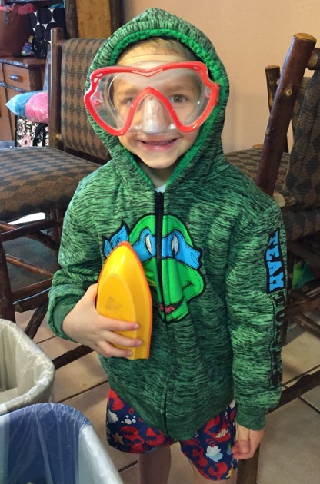

Slide 38
Brainstorming the First Steps
Identify 3 new partners
Identify 3 stakeholders
Identify 2 gaps in support in your area
Identify 3 potential funding sources

