Slide 1
Breastfeeding and Contraception
Jennifer Meyers
Certified Nurse Midwife
Mayo Clinic Health System

Slide 2
Breastfeeding and Contraception
Jennifer Meyers, CNM
Mayo Clinic Health System, La Crosse
No financial disclosures, brand names used only for clarification
Other disclosures: I’M NOT AN EXPERT.

Slide 3
Why do we care?
Most women want to delay conception after a pregnancy
Adequate birth spacing is good for babies AND moms
Contraception can potentially impact breastfeeding success

Slide 4
What factors affect choice of contraceptive?
Breastfeeding?
Cost
Previous experience
Health risk factors
Age
Chance of getting pregnant again
The internet!
Experiences of peers
Effectiveness of method
Ease of method
Recommendation of healthcare providers
partner’s opinion
Faith/religion
Insurance coverage
Availability of heathcare resources

Slide 5
needs of mom(birth control)
provider knowledge
needs of baby (milk!)
Sweet spot!

Slide 6

Hormones, baby!
Pregnancy: estrogen and progesterone are queens of the castle. Both increase.
(a woman will make more estrogen in one pregnancy than during their entire non-pregnant life!)

Slide 7
Hormones, baby!
Progesterone
  Relaxes smooth muscle
  Loosens joints and ligaments
  Helps internal organs/structures increase in size
Estrogen
  Increases vascularity to placenta, uterus
  Helps fetus develop and mature
  Plays role in milk duct development during 2nd trimester

Slide 8

Hormones, baby!
Labor/Delivery
  Oxytocin
  Endorphins
  Adrenaline

Slide 9
Hormones, baby!
Oxytocin
  “The love hormone”
  Stimulates contractions
  Baby secretes oxytocin, too… mom and baby both prepared to fall in love with each other!
Endorphins
  Help the body cope with pain and stress
Adrenaline
  Helps with fetal ejection reflex
  Increases burst of energy at end of labor
  Surge at birth helps baby be alert

Slide 10

Hormones, baby!
Progesterone and Estrogen
  Drop rapidly. Drop in progesterone responsible for onset of milk production.
  (oxytocin and prolactin do their thing, too)

Slide 11

Birth Control Options

Slide 12
Birth Control Options
BARRIER METHODS
  Block sperm from meeting egg.
  Examples: condoms, diaphragm, cervical cap, withdrawal
  Challenges can include decreased effectiveness, and reliability in use
  No risk to breastfeeding success

Slide 13


Slide 14
Birth Control Options
LACTATIONAL AMENORRHEA
  This IS a hormonal method, really…
  Highly effective (98%), no side effects
  No risk to breastfeeding relationship, milk, or baby
  Criteria:
    Only breastfeeding, no food/supplements
    No period back
    Baby less than 6 months old

Slide 15
A man calls his priest and tells him that he and his wife don't want any more children, "Should we try the pill?"
The priest asks, "Have you tried the rhythm method?"
"Where am I going to get a band at 3 o'clock in the morning?"

Slide 16
Birth Control Options
NATURAL FAMILY PLANNING
  Uses body’s hormonal signals to avoid intercourse during most fertile time
  Can be challenging during breastfeeding; body’s signals may be muted, unpredictable, and/or absent
  No side effects
    (frustration?)
  No risk to baby/breastfeeding

Slide 17
Birth Control Options
HORMONAL METHODS
  Combined hormonal methods (estrogen + progestin)
  Progestin-only methods

Slide 18
Hormonal Methods
Combined Oral Contraceptive Pills (COCPs)
  Prevents ovulation by increasing levels of estrogen and progesterone
  Easy to start and stop, quick return to fertility after stopping
  Reliable if taken as directed, but most don’t take as directed.

Slide 19
Hormonal Methods
COCPs effect on breastfeeding
  Theoretical: increases estrogen/progesterone which could affect ability to make milk
  Quality of research available: poor to fair
  Some studies show impact on supply and success if started before 6 weeks, some don’t.
  If started >6 wks, no effect on infant wt gain
  No evidence of impact on other health outcomes in baby

Slide 20
Hormonal Methods
NuvaRing and Patch
  Estrogen + Progestin, absorbed through vaginal mucosa or transdermally
  Less error than with the pill?
  Prevents ovulation
  Patch has fallen out of favor due to increased clotting risk
  very little data on effect on breastfeedng, suspect similar to COCPs due to similar mechanism of action

Slide 21

NuvaRing

Slide 22
Hormonal Methods
Progestin Only Pills (POPs)
  Create cervical mucus to block sperm from meeting egg
  We tell patients to take at the exact same time every day
  AND ideally at the time “that intercourse happens most”
  No placebo pills – very important to discuss with patients!
  Effect on breastfeeding: doesn’t seem to impact lactation or infant weight gain

Slide 23

Progestin-only Pills

Slide 24
Hormonal Methods
Progesterone Vaginal Ring
  Not available in U.S. currently
  Like NuvaRing, but only progestin
  Doesn’t need the compliance level of a POP
  Evidence suggests no risk to breastfeeding success or infant growth

Slide 25
Hormonal Methods
Nexplanon
  Rod implanted under the skin of upper arm
  Progestin-only, inhibits ovulation
  Nearly 100% effective, easily reversed
  Even with immediate placement, no documented adverse outcomes on lactation or infant growth
  Discontinued most often due to unpredictable vaginal bleeding

Slide 26
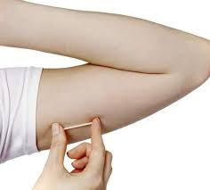
Nexplanon

Slide 27
Hormonal Methods
Depo Provera
  Injection given every 3 months
  Inhibits ovulation
  Slow return to fertility (up to 1-2 yrs)
  Side effects: weight gain, depression, irregular bleeding, amenorrhea
  Can’t easily reverse if unpleasant side effects
  May impact breastfeeding/infant weight gain if given immediately postpartum, often best to wait 6 weeks, although evidence quality is poor (hmmm, I see a theme here…)

Slide 28
Hormonal Methods
Intrauterine Contraceptives (IUCs)
  Progestin-containing: Mirena (5 yrs), Skyla (3 yrs)
  Copper IUD: Paragard

Slide 29
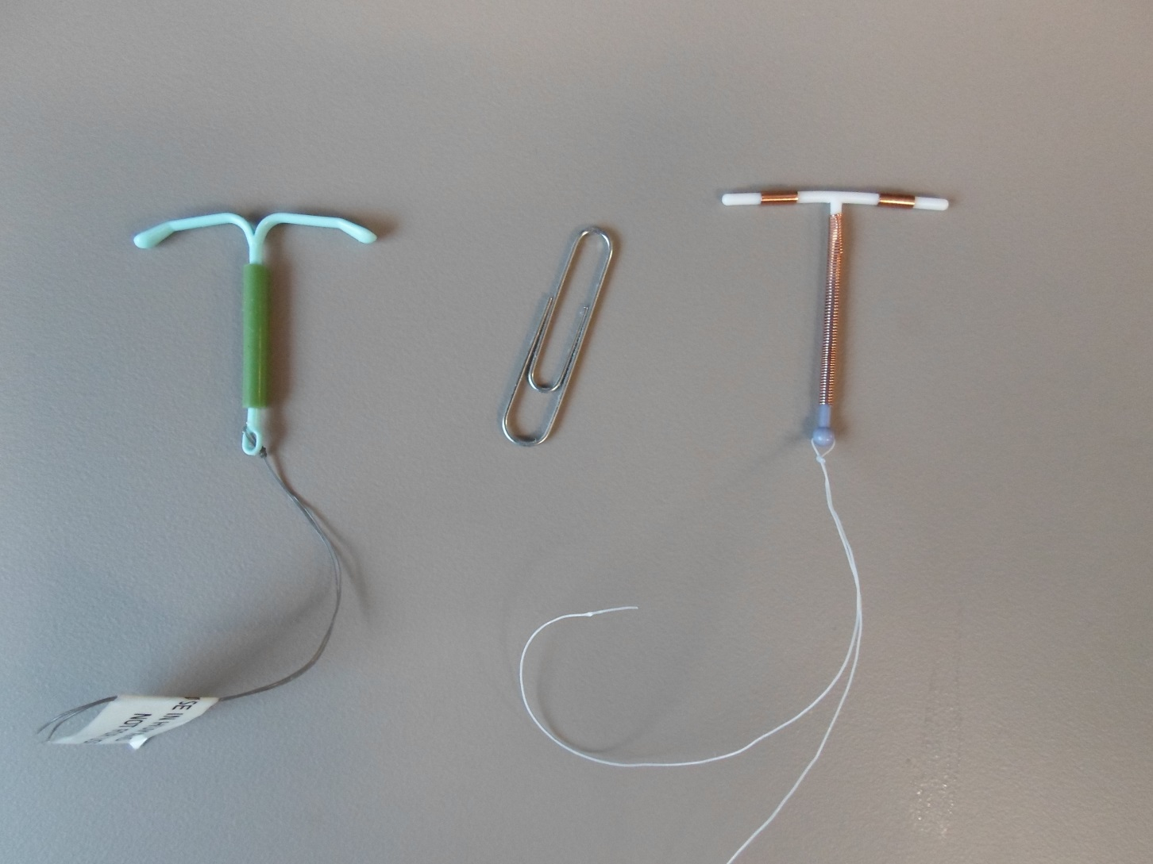
IUCs

Slide 30
IUCs
Extremely effective (>99%)
Very well tolerated by most
Easily reversible
No room for user error
Quick return to fertility
Risks include uterine perforation, expulsion, infection , ectopic pregnancy if pregnancy does occur

Slide 31
IUCs
Paragard
  Copper-containing IUC
  Effective for up to 10 years
  Works primarily by disabling sperm but may also act as a contragestive (not allowing fertilized egg to implant)
  No evidence of impact on breastfeeding, infant growth or other infant outcomes even if placed immediately postpartum
  Most often discontinued due to heavier, more painful periods

Slide 32
IUCs
Mirena and Skyla
  Contain progestin
  Effective for 5 and 3 yrs respectively
  Work primarily by creating cervical mucus to block sperm from meeting egg
  May be related to shorter duration of breastfeeding if placed <6 weeks, but no effect if placed >6 weeks

Slide 33
Permanent Contraception
Tubal Ligation: “tubes tied”, surgery
Essure procedure: springs inserted into fallopian tubes, nonsurgical
Vasectomy
Theoretical risk of tubal ligation or Essure separating mom/baby, otherwise no effect on breastfeeding

Slide 34
Emergency Contraception
Plan B most common, prevents ovulation most likely
Copper IUD: most likely contragestive effect, effective up to 5 days post-coitus
No effect on breastfeeding with limited data

Slide 35
Summary: Contraceptive Effects on Breastfeeding
Amount of evidence is lacking
Quality of evidence is poor to fair
Almost all contraceptives seem to have small to no effect on bf success or infant weight gain if started later (>6 weeks)
No data to suggest risk to baby’s health

Slide 36
What are most healthcare providers telling their patients?
If breastfeeding, many usually advise minipill or IUD
Underestimate how effective true lactational amenorrhea is
Limited on time, breastfeeding goals may not be on the agenda

Slide 37
What Can We Do?
Educate LCs and healthcare providers
Improve communication between lactation staff and midwife/physician
Lactation visits DURING pregnancy
Offer 2 week visit in addition to 6 week postpartum visit

Slide 38
Factors to Consider in Choosing a Contraceptive
How much at risk is patient of another pregnancy?
Breastfeeding goals
Breastfeeding & birth control history
Increased risk of lactation failure:
  Hx of low milk supply
  Diabetes or polycystic ovarian syndrome
  Multiples
  Preterm birth
  Compromised health mom/baby
  Breast surgery

Slide 39
Case Example #1
Sara. 16 year old G1P0, 39 weeks gestation. Is asking “how soon after delivery can I have sex?”. Patient is obese, has acne and periods were very irregular prior to pregnancy. Having some issues in relationship with FOB. Wants to breastfeed, would be first woman in immediate family to do so.

Slide 40
Case Example #1, cont.
What are some concerns about Sara’s situation?
What barriers to breastfeeding are there?
What would some appropriate birth control methods be for Sara? What might not be a good idea?
What could be done to help promote effective breastfeeding?

Slide 41
Case Example #2
Molly, G2P1, just had NSVD. First child is 18 months. Seeing midwife for 2 week postpartum visit. Is a stay at home parent, successfully breastfed first baby. Is feeling overwhelmed with two small children, really worried about getting pregnant on accident. Used condoms after first baby.

Slide 42
Case Example #2, cont.
What might some good birth control options be for Molly?
What might some new challenges be this time around for her?

Slide 43
The Takeaway
We need MORE and BETTER evidence!
Providers need more education, time, direction and communication
Plans should be individualized based on mom’s goals, risk of future pregnancy, and barriers to effective breastfeeding

Slide 44
THANK YOU!

Slide 45
References
Berens, P., & Labbok, M. (2015). ABM Clinical Protocol #13: Contraception During Breastfeeding, Revised 2015. Breastfeeding Medicine.
Braga, G., Ferriolli, E., Quintana, S., Ferrani, R., Pfrimer, K., & Vieira, C. (2015). Immediate postpartum initiation of etonogestrel-releasing implant: A randomized controlled trial on breastfeeding impact. Contraception.
Carr, S., Gaffield, M., & Phillips, S. (2015, April 11). Safety of the progesterone-releasing vaginal ring (PVR) among lactating women: A systematic review. Contraception, 136-141.
Childbirth Graphics. Hormones of Labor and Birth. (n.d.). Retrieved November 10, 2015, from http://www.childbirthgraphics.com/index.php/articles/hormones-of-labor-and-birth/

Slide 46
Kapp, N., Curtis, K., & Nanda, K. (n.d.). Progestogen-only contraceptive use among breastfeeding women: A systematic review. Contraception, 17-54.
Krucik, G. (n.d.). What Bodily Changes Can You Expect During Pregnancy? Retrieved November 10, 2015.
Lopez, L., Grey, T., Steube, A., Chen, M., Truitt, S., & Gallo, M. (2015, March 20). Combined hormonal versus nonhormonal versus progestn-only contraception in lactation. Cochrane Database of Systematic Reviews.
Mwalwanda, C., & Black, K. (n.d.). Immediate post-partum initiation of intrauterine contraception and implants: A review of the safety and guidelines for use. Australian and New Zealand Journal of Obstetrics and Gynaecology, 53, 331-337.

Slide 47
Nath, A., & Sitruk-Ware, R. (2010, November 1). Progesterone vaginal ring for contraceptive use during lactation. Contraception, 428-462.
Phillips, S., Tepper, N., Kapp, N., Temmerman, M., & Curtis, K. (2015, September 24). Progestin-only crontraceptive use among breastfeeding women: A systematic review. Contraception, 585-590.
Tepper, N., Phillips, S., Gaffield, M., & Curis, K. (2015, May 19). Combined hormonal contraceptive use among breastfeeding women: An updated systematic review. Contraception, 218-226.

