Slide 1
Infant Proctocolitis
Anne Eglash MD, IBCLC, FABM
Clinical Professor
Dept of Family Medicine
University of WI School of Medicine
and Public Health

Slide 2
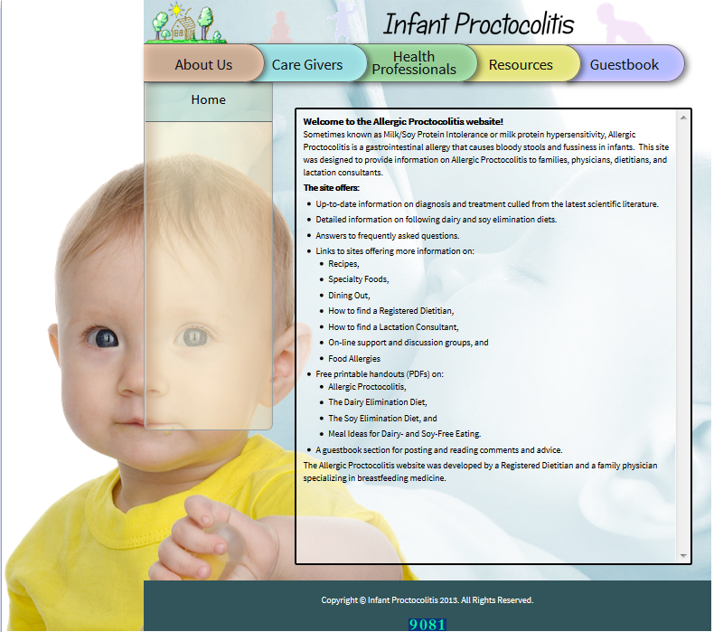

Slide 3
What is Allergic Proctocolitis?
An immune-mediated hypersensitivity GI disorder
Not mediated by IgE
Occurs in the large bowel
Instigated by food allergens in the gut
Maternal dietary allergens
less likely from allergens in formula or solids

Slide 4
IGE Mediated Gastroenteritis
Exposure to certain antigens causes release of allergic inflammatory mediators.
Nausea, vomiting, diarrhea, abdominal pain
Symptoms occur within minutes
Other classic allergic symptoms such as wheezing, rash, swelling, hives anaphylaxis
Eosinophilic esophagitis, gastritis, gastroenteritis
GERD, refusal to eat, poor growth, irritability, poor food tolerance

Slide 5
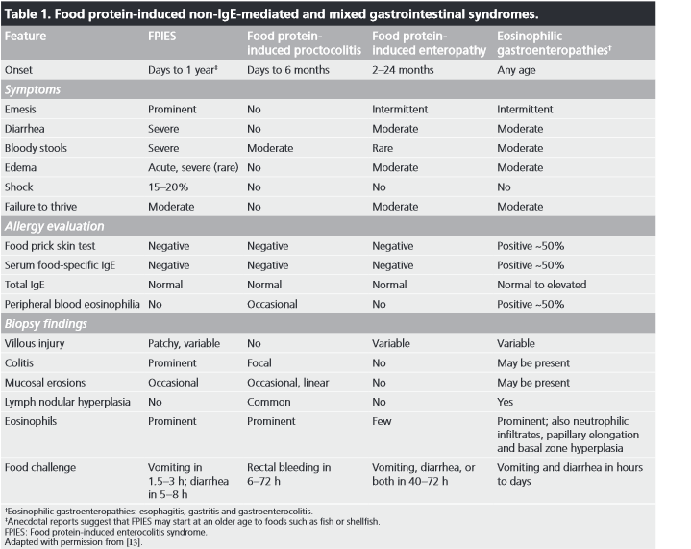
Expert Rev. Immunol 2011 7(3), 317-327

Slide 6
Food Protein-Induced Enterocolitis Syndrome (FPIES)
May be acute or chronic presentation
Sudden nausea/vomiting/dehydration
Can be severe leading to shock
Weight loss or failure to gain weight
Abdominal pain, low serum protein, malabsorption
No diagnostic test available
Often have to rule out infectious disease or toxin exposure
Not typically related to breastfeeding
Often reported in infants fed cows milk or soy based formula
Many different allergens
Milk, soy, poultry, grains, veggies (any food can do it)
Rice is the most common solid food
Reaction starts after several exposures to the protein
Improvement within days of removing offending food
Often starts before 9 mo, usually resolves by age 3
At least 30% of infants eventually have allergies

Slide 7
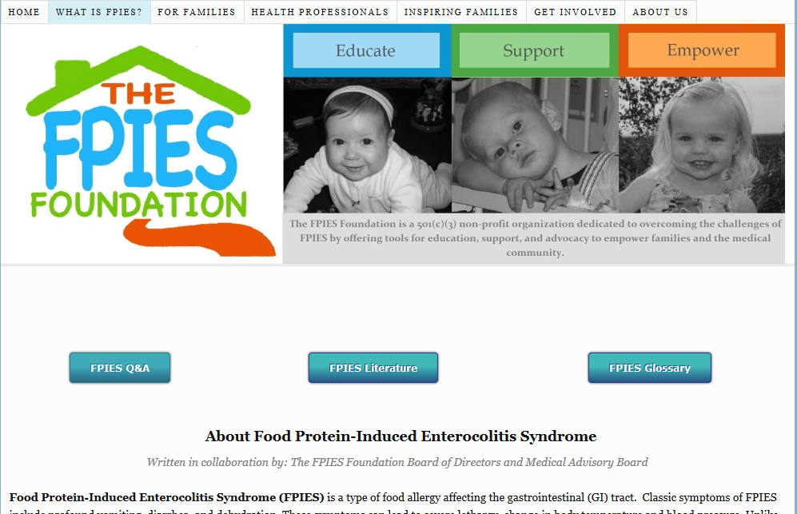

Slide 8
Management of FPIES
Most children will have negative skin testing and RAST
Take away offending food antigens
If reintroduced in a few days, symptoms can be severe
Try to avoid an oral food challenge
Reintroduce the food again in 12-18 months
Kids usually are triggered by 1 main food protein group
Milk and soy; rice and oats
No medications prevent the reaction
Unclear if epinephrine helps at onset of sx

Slide 9
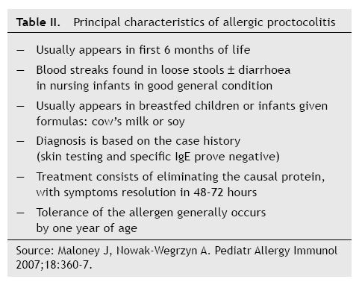

Slide 10
Relationship between FPIES and Allergic Proctocolitis
Allergic proctocolitis may be a milder form of FPIES
FPIES usually occurs in the rectum, along with other areas
The protective factors in breastmilk may prevent full expression of FPIES
Exposure to antigens are much less in breastmilk
Only 1 case report of FPIES in exclusively breastfed infants

Slide 11
Food Protein-Induced Enteropathy Allergology International 2013;62 297-307
Chronic diarrhea and poor growth in first few mo of life
Similar to Celiac Sprue, not related to gluten
Small intestine villous atrophy
Few reports of this in the last few decades

Slide 12
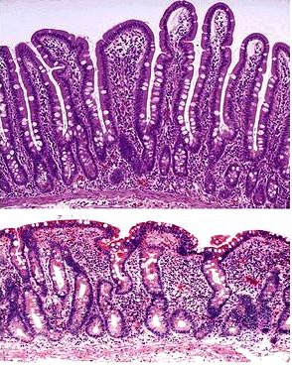

Slide 13
Allergic Proctocolitis

Slide 14
Incidence of Allergic Proctocolitis
Not well defined
Often hard to separate out from other food-protein induced GI illnesses
Approx 0.5-1% of breastfed infants have an allergy to dairy while nursing (based on 1 study)

Slide 15
Typical Presentation
Bloody, mucousy stools
Usually 2-6 weeks of age, but can be 1 day- 4 months
The baby appears well
Rare anemia
Good growth
Occasionally fussy
Other sx such as vomiting, GERD, failure to gain may imply additional or other enteropathy

Slide 16
Diagnosing Allergic Proctocolitis
Other labs usually not helpful
All other labs should be negative
Normal abdominal film
Negative stool cultures
Normal blood count

