Slide 1
Using a Physiologic Approach to Help Mothers with Low Milk Supply
Jenny Thomas, MD, MPH, IBCLC, FAAP, FABM

Slide 2
Objectives
Understand normal breast growth and the ways human milk is produced and regulated
Understand the consequences of disruptions in this normal physiology
Incorporate this understanding in to the evaluation, treatment and support of the mother with low milk supply
Be able to recognize and support the mother with perceived insufficient milk supply

Slide 3
Clues
Timing of low supply
Never had milk
Has some but not enough
Had plenty, now doesn’t
Sick or not sick

Slide 4
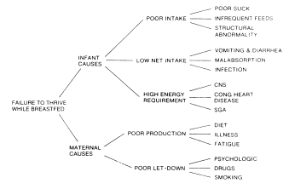
J Hum Lact 1999 15: 339 Vicki Bodley and Diane Powers Progesterone Treatment for Luteal Phase Defect

Slide 5
Breast Development
Did you experience breast growth during pregnancy?

Slide 6
Embryogenesis
Mammary ducts must grow into an adipose tissue pad if morphogenesis is to continue. Only adipose stroma supports ductal elongation. The mammary epithelium is closely associated with the adipocyte-containing stroma in all phases of development
Estrogen is essential to mammary growth. Ductal growth does not occur in the absence of ovaries The increase in estrogen at puberty results in mammary development. Although estrogen is essential, it is not adequate alone.
Prolactin is necessary for full alveolar development. Further, when prolactin is withdrawn, apoptosis of the alveolar cells occurs.

Slide 7
Embryogenesis
The exact location of the estrogen receptors in human breasts is unclear. Estrogen receptors are not in the proliferating cells and have not been located in the stroma. Cells with estrogen receptors, however, secrete a paracrine factor that is responsible for the proliferation of ductal cells. This paracrine factor may hold the key to understanding both normal and abnormal breast development.
In addition to estrogen, the pituitary gland is necessary for breast development. Growth hormone is important to pubertal development and development of the terminal end buds in the breast. Progesterone secretion brings about the side branching of the mammary ducts.

Slide 8
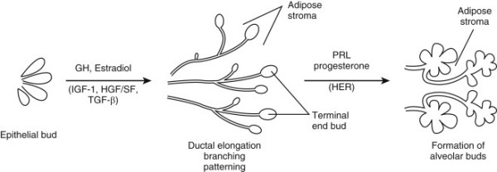
Lawrence, Lawrence Breastfeeding: A guide For the medical profession

Slide 9
Breast Development
Fetal life: epithelial bud sprouting
Postnatal life: extensive branching morphogenesis continues
Puberty: exponential epithelial outgrowth during; the fat pad rapidly fills with epithelia to produce the adult breast.
Mature breast tissue: undergoes only minor changes, largely dependent on the stage of the menstrual cycle.
Late pregnancy: prominent differentiation, ultimately becoming competent for functional lactation .

Slide 10
Breast Development
Early breast development is regulated by endogenous hormones—
mainly estrogen, which promotes growth of the ducts
progesterone, which promotes lobuloalveolar development
The mammary gland is also an autocrine/paracrine tissue, producing and responding to hormones produced by its own cells.

Slide 11
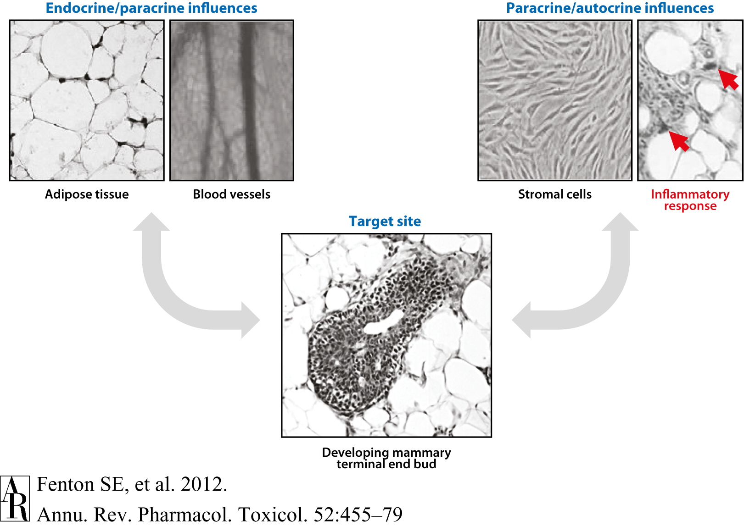
Annual Reviews

Slide 12
Pregnancy
Then we need the pregnant breast to create the ducts, lobules and supporting structures to create milk.
These are created by prolactin, progesterone and chorionic gonadotropin.
Breast growth in pregnancy, unlike puberty, has little to do with estrogen.

Slide 13
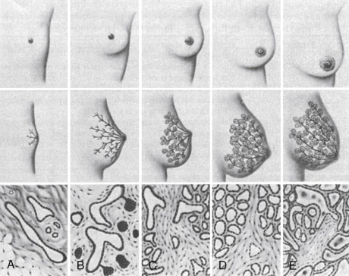
Lawrence, Lawrence , Breastfeeding: A Guide For the Medical Profession, 7th edition

Slide 14
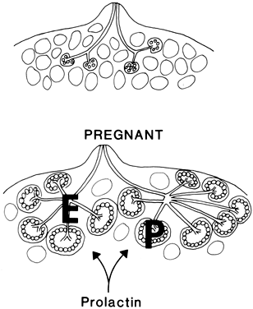

Slide 15
Potential Abnormalities
Failure to develop any part of the breast structure (congenital anomalies)
Acquired breast abnormality
Usually iatrogenic .
Chest wall trauma in premature infants when chest tubes are inserted.
Biopsy in prepubertal girls may remove vital tissues.
Cutaneous burns to the chest wall may result in scaring and breast deformity.
Other trauma

Slide 16
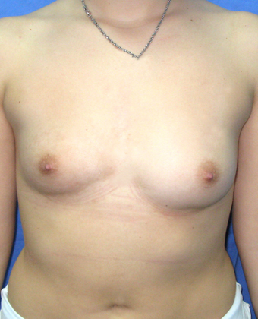
This woman had an implant to correct the asymmetry, so not all histories of implants are benign.

Slide 17
Environmental influences
Environmental exposures and endogenous signals may affect endocrine organs as well as tissues near the mammary gland (like fat)
Can then send altered messages through the vascular system, culminating in altered mammary gland development.
Mammary tissue may also be a direct target of environmental exposures; epithelia, fibroblasts, fat cells, and inflammatory cells express unique and shared receptors that are targets for environmental chemicals.

Slide 18
Health risk as adults associated with premature puberty
Accelerated skeletal maturation and short adult height
Depression
Early sexual interests; risk-taking behaviors such as smoking, using alcohol and drugs, engaging in unprotected sex
Psychosocial and behavioral difficulties
Obesity and eating disorders
Type 2 diabetes and insulin resistance
Cardiovascular disease and hypertension
Increased breast and reproductive cancers
Asthma
Polycystic ovarian syndrome
Suzanne E. Fenton, Casey Reed, and Retha R. Newbold
Perinatal Environmental Exposures Affect Mammary Development, Function, and Cancer Risk in Adulthood Annual Review of Pharmacology and Toxicology Vol. 52: 455-479

Slide 19
Compound | Delayed MG development
Compound | Delayed /Altered Breast Development
Atrazine | √
Bisphenol A
Dieldrin | √
Dioxin or TCDD | √
Organochlorines | √
Phthalates | √
PCBs | √
PhIP | √
PFOA | √
High-fat diet (PUFA) | √
PBDE | √
Ziracin™ (antibacterial) | √
Suzanne E. Fenton, Casey Reed, and Retha R. Newbold
Perinatal Environmental Exposures Affect Mammary Development, Function, and Cancer Risk in Adulthood Annual Review of Pharmacology and Toxicology Vol. 52: 455-479

Slide 20
Regulation of Production
Do you have any ongoing medical problems?

Slide 21
During Pregnancy
Human Placental Lactogen (HPL) and Progesterone prevent milk release.
Progesterone sensitizes mammary cells to the effects of insulin
Thyroid hormones increase sensitivity to prolactin

Slide 22
Normal Milk Production
Secretory Differentiation
Mammary epithelial cells differentiate into lactocytes with the capacity to synthesize unique milk constituents such as lactose.
Needs a “lactogenic hormone complex” including estrogen, progesterone, prolactin
Pang, Hartmann: initiation of human lactation: secretory differentiation and secretory activation, J Mammary Gland Biol Neoplasia 12: 211-221, 2007

Slide 23
Normal Milk Production
Secretory activation
Initiation of copious milk secretion associated with major change in many milk constituents
Triggered by withdrawal of progesterone
Requires prolactin, insulin and cortisol
Pang, Hartmann: initiation of human lactation: secretory differentiation and secretory activation, J Mammary Gland Biol Neoplasia 12: 211-221, 2007

Slide 24
Lactogenic Hormone Complex
Estrogen in pregnancy helps increase prolactin.
The creation of milk also needs insulin, to help increase the number of supporting structures.
Cortisol needs to be around to help with the formation of alveoli.

Slide 25
Lactogenic Inhibition
Breastmilk can be secreted by 16 weeks of gestation
Milk secretion is held in check by progesterone and human placental lactogen (HPL), both of which are formed by the placenta.
The receptors that help with making milk like both prolactin and placental lactogen, but preferentially bind HPL

Slide 26
Problems here: Immediate
Several culprits:
Hypoplastic (underdeveloped) breasts from puberty.
Insufficient glandular tissue
Poorly controlled diabetes which would affect insulin and its actions.
Polycystic ovarian syndrome (PCOS) where the body doesn’t respond to insulin the way it’s supposed to.
Problem with hormones that control prolactin. An abnormality of any of them may impact supply.

Slide 27
What to do if there really is “no milk”
If the answer to our breast growth question is “no” then we might need to set some realistic expectations for milk supply. If we didn’t create the structures, we’ll have milk production issues.

Slide 28
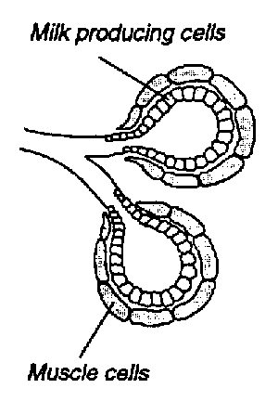
Regulation
Prolactin: mediates CNS regulation of milk secretion. Influenced by rate of milk removal by infant.
Oxytocin: neuroendocrine
reflex that stimulates
myoepithelial cells,
which then force milk
into the ducts (MER)

Slide 29
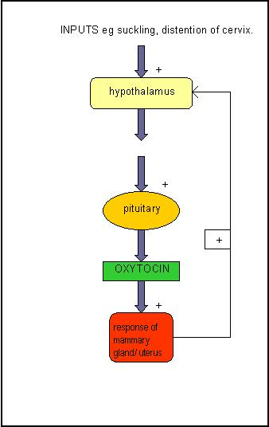
Regulation of Oxytocin

Slide 30
Prolactin
Store (probably create) prolactin in pituitary secretory granules.
Prolactin inhibited by dopamine-only substance to be constantly inhibited
Dopamine keeps the secretory granules full. Catacholamines control dopamine.
Suckling decreases dopamine, prolactin surges from granules.

Slide 31
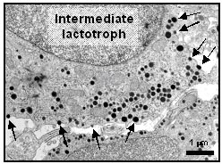
Arrows indicate prolactin containing secretory granules

Slide 32
Prolactin
Known component of breastmilk
Made by the lactating breast.
As a part of breastmilk, it exerts immunomodulating effects in the newborn when it helps with lymphocyte cell growth and function.
Prolactin in milk also influences maturation of gastrointestinal epithelium.

Slide 33
Prolactin
The concentration of prolactin is highest in the first 3 days of life when it exerts crucial neuroendocrine effects. These effects condition behavior responses in later life.
Prolactin can be affected by insulin, cortisol, thyroid hormones, parathyroid hormones and growth hormone.

Slide 34
Reglan and Domperidone
Interesting review from the Cochrane Database on "Medications for increasing milk supply in mothers expressing breastmilk for their preterm hospitalized infants."
Their criteria for study inclusion resulted in only finding 2 adequate studies, both of which used Domperidone and only involved 59 mothers (so a small sample). They found that prophylaxis with medication like Reglan didn't work. But that in the 2 studies that used Domperidone:
"These studies showed a modest improvement in EBM volume over the following one to two weeks. No side effects to mothers or infants were noted in these studies.
These medications should only be considered in mothers who have received full lactation support and are more than 14 days post
delivery but have insufﬁcient EBM for their infants’ needs.”

Slide 35
Prolactin and Obesity
The prolactin response to suckling is very important, especially during the time of the transition to copious milk production in the first week post-partum.
Overweight and obese women (BMI>26) had a lower prolactin response to suckling during this critical time for milk production.
Many overweight/obese women stop breastfeeding early, during this time of transition to more milk production -likely due to this low prolactin response to suckling and lack of increasing milk supply in those early days.
Lactation support is critical for these moms and babies because after day 7, the response to prolactin is the same as non-obese women.

Slide 36
Oxytocin
Love hormone
Sexual intercourse, Childbirth and Lactation
Can be inhibited by adrenaline
Stop labor until safer surroundings are found
Inhibit MER until the pair can safely feed

Slide 37
Oxytocin
Oxytocin can be released under many circumstances
Prolactin however is only released by stimulation of the breast.
The 4th intercostal nerve is responsible for taking the information about suckling to the brain.

Slide 38
Problems with regulation and production
So low milk supply issues here could come from insulin issues (again)
Disorders of regulation of cortisol, thyroid hormones, parathyroid hormones and growth hormone.

Slide 39
Problems with regulation and production
Fourth intercostal nerve damage:
Previous trauma (car accidents, biopsies…)
other breast/thoracic surgery
Breast reduction surgery
Removes the nipple entirely
If the mother has areolar sensation, we have a chance of achieving a milk supply, maybe not a full one
Setting realistic expectations

Slide 40
Problems with regulation and production
Dopamine- agonists
ADHD meds
Wellbutrin
Cause some decrease in supply because they increase dopamine, and therefore may decrease prolactin.

Slide 41
Problems with regulation and production
Continue to treat the underlying illness
If starting a new anti-depressant, Wellbutrin is not a good choice.
If the mother has had good results with Wellbutrin, no need to switch the medication

Slide 42
Problems with regulation and production
Oxytocin suppression
Tigers
Define “tiger” however you’d like, but stress of any sort can inhibit the milk ejection reflex.
Alcohol

Slide 43
First Several days

Slide 44
First hours
The placenta comes out and with it progesterone levels drop way down.
With progesterone gone, milk synthesis increases.
Then we need insulin, prolactin and cortisol to continue production.
So, the milk secretion in the first few days is an endocrine process, not "demand and supply” until the 3rd or 4th day, when milk supply drops if the milk is not removed from the breast.
The baby still needs to nurse frequently and with a correct latch, get skin-to-skin and all those good things, but
Process here is endocrine, so it’s very, very unusual for a mother to have “nothing.”
Colostrum can be secreted without the baby’s help.

Slide 45
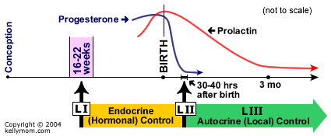

Slide 46
Timing- First Few Days
Poor supply
Retained placental fragments.
Depo-provera as a contraceptive.
Poor insulin regulation
insulin dependent or gestational diabetes ,PCOS
delay in the transition to a larger milk supply.
C-sections may cause a delay in transitioning to a larger milk supply.
Post-partum heavy bleeding falls into this section as well.
Confidence rotting
Not understanding normal newborn behavior

Slide 47
First Few Days
Problem solving
Depo:
We have no idea who will have a drop in supply because of that Depo injection.
Suggest progestin only pill that you can stop if it drops supply.
Insulin
Continue metformin

Slide 48
After the first few days
How’s the latch?

Slide 49
After the First Few Days
Now we have demand and supply.
We need a good latch.
The more milk out, the more you get

Slide 51
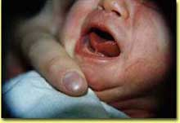

Slide 52
After the First Few Days
Poor supply
Any number of latch issues
Tongue-tie
Other baby anatomical issues like cleft lip and palate.
Supplementation
Birth weight
Bilirubin
Blood sugars
Confidence

Slide 53
Perceived Insufficient Milk Supply
Do, or do not. There is no try.
Misperception of actual milk supply
Mothers are supplementing and weaning because they feel as if they have "no milk" or "I can't satisfy him“

Slide 54
Perceived Insufficient Milk Supply
Is as important as Star Wars.
It's a cultural phenomenon. It's everywhere.
It's marketed, and grosses lots of money.
And the story is passed down from generation to generation.

Slide 55
Perceived Insufficient Milk Supply
About 35% -80% of women cite perceived insufficient milk supply as a reason for weaning.
Other authors go as high as 80%.
The most common reasons for the perception that a mother's body can't make enough milk for her baby:
Lack of confidence
She can't satisfy your baby- lack of understanding normal newborn behavior at the breast
Crying

Slide 56
Perceived Insufficient Milk Supply
Lack of social support
one study put the blame squarely on the mother-in-law's disapproval.
Marketing practices of infant formula companies
Non-evidence-based maternity care practices
Maybe "I don't have enough milk" is a socially acceptable way to stop breastfeeding.

Slide 57
Health risk as adults associated with premature puberty
Accelerated skeletal maturation and short adult height
Depression
Early sexual interests; risk-taking behaviors such as smoking, using alcohol and drugs, engaging in unprotected sex
Psychosocial and behavioral difficulties
Obesity and eating disorders
Type 2 diabetes and insulin resistance
Cardiovascular disease and hypertension
Increased breast and reproductive cancers
Asthma
Polycystic ovarian syndrome
Suzanne E. Fenton, Casey Reed, and Retha R. Newbold
Perinatal Environmental Exposures Affect Mammary Development, Function, and Cancer Risk in Adulthood Annual Review of Pharmacology and Toxicology Vol. 52: 455-479

Slide 58
After Breastfeeding is Going Well
Work, pumping
Contraception
Depression
Baby sleeping longer
Pregnancy
Oversupply- never established a good latch
New medications

Slide 59
Appropriate Supplementation

Slide 60
Supplementation

Slide 61
Supplementation not indicated
Sleepy infant with fewer than 8-12 feedings in the first 24-48 hrs with less than 7% weight loss and no sign of illness
An awake baby is a hungry baby
Increased skin to skin can help encourage more frequent feeding

Slide 62
Supplementation not indicated
The healthy, term, AGA infant with bilirubin levels less than 18 after 72 hours of age when the baby is feeding well and stooling and the weight loss is less than 7%.

Slide 63
Supplementation not indicated
The infant who is fussy at night or constantly feeding for several hours.
The tired or sleeping mother

Slide 64
cases

Slide 65
Jessie
Jessie is a 28 year old mother of two who just returned to work. She is pumping every four hours and getting about 3 ounces of milk (total) each times she pumps. She had a “great supply” when she was at home with her son, but since going back to work, her supply is decreasing. She would like a prescription for Domperidone.

Slide 66
Leanna
Leanna is a 35 year old first time mother who was able to conceive after the use of metformin and clomid. She stopped both drugs after conception. She had drops of colostrum for the first few days after delivery, but feels as though her milk isn’t coming in. What can she do?

Slide 67
Robin
Robin is a 24 year old first time mom who had an uncomplicated pregnancy and birth. She has some milk production but notices a marked discrepancy between the production of her right and left breast. In fact, the left breast is “not producing any milk.”

Slide 68
Katie
Katie has a 4 month old daughter. Their nursing relationship was going fine until it abruptly changed about 1 week ago. Now the baby is crying all the time, there are less wet diaper, the stool is thicker and mom is confused as to what happened. She recently has a Mirena IUD placed, but understood that an IUD would be a safe form of contraception during lactation.

Slide 69
Mrs. Thomas
Mrs. Thomas is a 24 ­year ­old first time mother who comes in for evaluation of low milk supply. The 7­week ­old baby had gained weight well until the last 2 weeks when the mother noticed less wet diapers and a decrease in the volume she was able to pump.
Prior to this visit with you, she had been evaluated by a lactation consultant. At a visit 1 week ago, pre­ and post-­feeding weights showed low transfer of milk, but no nipple trauma. Her son now has a coordinated suck and swallow, asymmetric latch with a wide angle of the jaw. The mother holds the infant in a neutral position with the head slightly extended. The mother had been healthy prior to the pregnancy, had no pregnancy complications and had an unremarkable labor and delivery. Her breast exam was normal.

Slide 70
Mrs. Thomas
Mother’s concerns:
The baby never seems satisfied unless he is breastfeeding, otherwise, he is crying
Her in-laws, who recently arrived to help
with the baby, have encouraged her to stop
breastfeeding because he seems so unhappy
She doesn’t think the baby likes her
She isn’t sleeping well
She feels as if she has already failed as a mother

Slide 71
Mrs. Thomas
Probing questions:
What factors might contribute to the change in milk supply?
How might you counsel this mother? Her
family?
What are some ways to help this mother
increase her milk supply?

Slide 72
Kassidy
Kassidy is a 3 ­day ­old exclusively breastfed girl, born at term after an induced vaginal delivery. The baby nursed well in the delivery room within an hour after delivery. She has been feeding every 3 hours since. The baby’s last stool, about 18 hours ago, was black and tarry. The baby and mother have the same blood type. A bedside transcutaneous bilirubin measurement at 24 hours of age places the baby in the “high intermediate” range.

Slide 73
Kassidy
Mother’s concerns:
•Her nipples are cracked and bleeding
•Her breasts are soft and it doesn’t seem as
though her milk has “come in” yet
•The baby has lost weight
•The baby does not seems as alert as she was
the day before

Slide 74
Brady
Brady is a 7­month ­old boy brought in by his mother 1 month late for his 6­month well visit and his pediatrician has concerns about his growth. He receives well child care through a clinic at his mother’s workplace. His weight, consistently plotted on the CDC Growth Chart, has decreased from the 75th percentile at 4 months of age to the 10th percentile at this visit. He is being referred for an evaluation of failure to thrive.
Background Information: He is the second child for these parents. He was born at term after a vaginal delivery and uncomplicated pregnancy. He has been exclusively breastfed, with initiation of solid foods at around 6 months of age. His mother feels as if her milk supply is adequate and has experienced no change in the volume of breast milk. She is able to pump while at work. He has started solid food and has no feeding difficulties. He has met all developmental milestones. He has maintained his height and head circumference. He has had no vomiting, diarrhea or irritability. His mother is 64 inches tall. His father is 69 inches tall.

Slide 75
Brady
Mother’s Concerns:
She originally didn’t have any, but has become concerned due to the attention being paid to her son’s weight
She is curious about the richness of her milk
She would like to know what supplements either she or her son should be taking
Questions:
Is this baby’s growth pattern abnormal?
How do the CDC Growth Charts differ from the WHO Child Growth Standards?
What advice would you give this mother?
What other questions should you ask, and what physical findings should you look for
before making a diagnosis?
What do you think about the referral for failure to thrive?
Would you provide any additional nutritional guidance?

Slide 76
CDC
Growth reference
Survey of population of US
Birth weight data from those states that include that info on the birth certificate
How kids in the US are growing

Slide 77
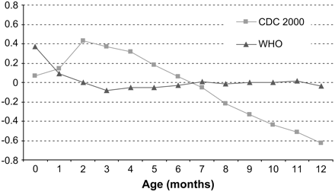
Weight for age healthy bf

